Slide 1

Software Engineering Personalization: Fitts
Team 2
Members: 빙, 장한빈, 하지크, 임근식
Github: https://github.com/skkuse-adv/2019Fall_team2/

Slide 2


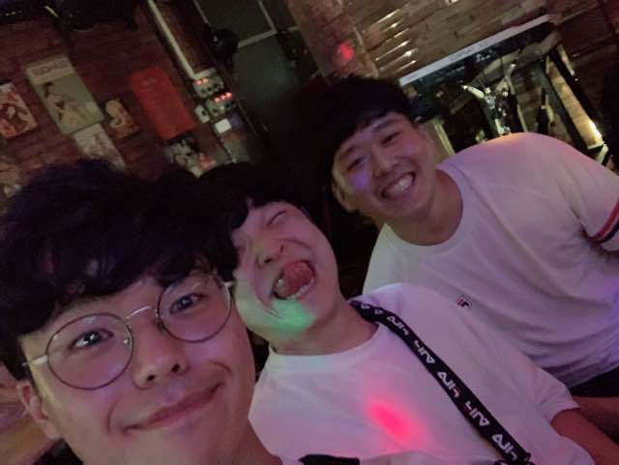

Members of Team 2
빙
하지크
장한빈
임근식

Slide 3
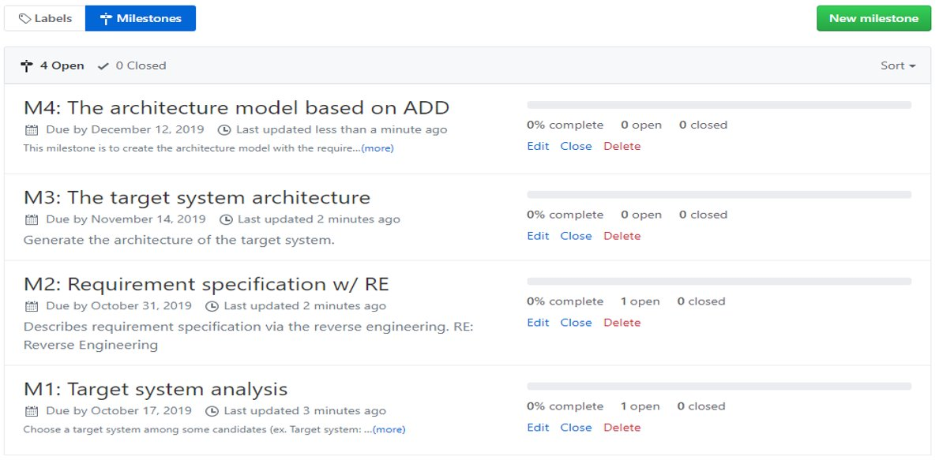
Milestone
Our team defined four milestone for the projects. The goal is to propose new application architecture after analyzing Fitts.

Slide 4
Presentation agenda
01
What is Fitts?
02
System configurations
03
Main functions
04
Reasons for selection
05
Related existing systems

Slide 5

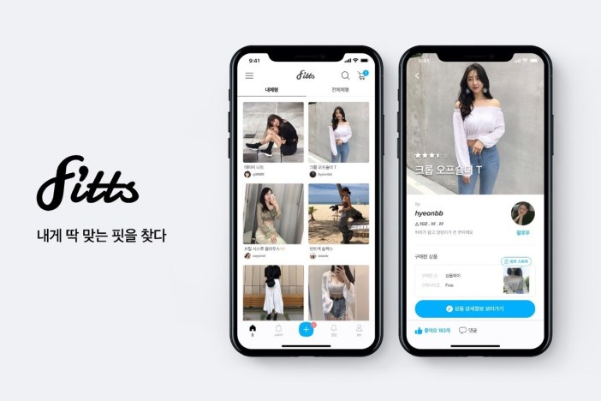
01
What is Fitts?
Fitts is an e-commerce platform that aims the fashions market
Review centric apps
Ensure clothes fits user’s body
No advertisement, sincere review
Website: https://fitts.co.kr/
Company: 포포네 (POPONE Co., Ltd)
대표이사: 이운학
서울 서초구 반포대로 30길 81 12층

Slide 6
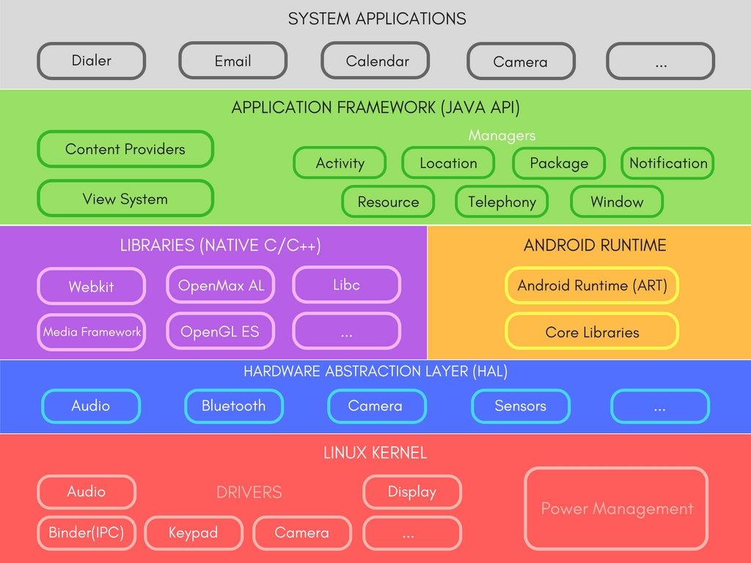
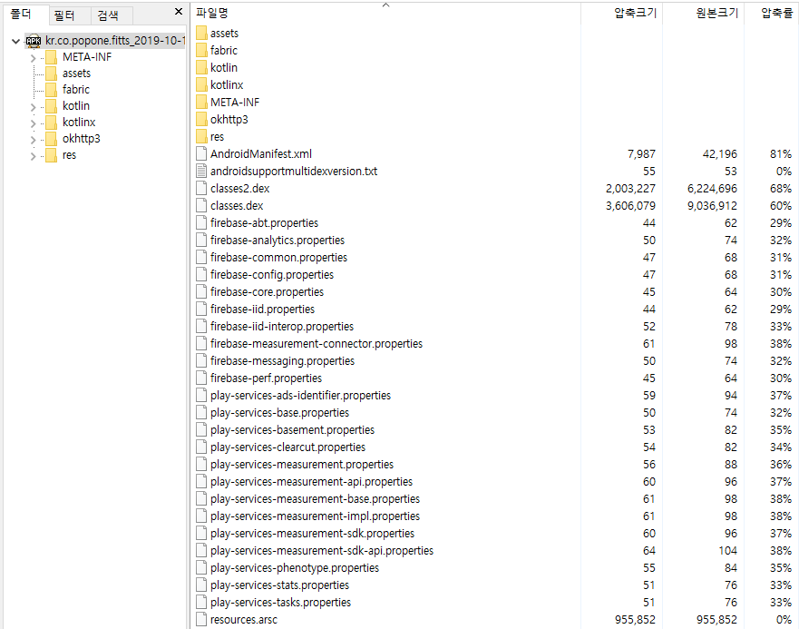

02
System configurations
Basic Configuration
M1: Fitts
M2:
In this project, we are going to use Android stack instead of iOS stack for doing the reverse engineering of Fitts.

Slide 7




02
System configurations
Software Platform: Android (Apache2)
OS: Linux Kernel (GPLv2)
Low-level Libraries: C/C++, LLVM
Application: Java/Kotlin
Data Parser: XML

Slide 8



02
System configurations
Build System:
NDK
Gradle
Software Development Kit (SDK): Android Studio

Slide 9
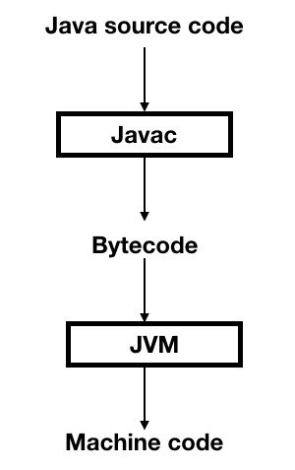
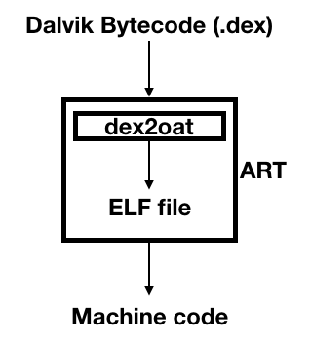
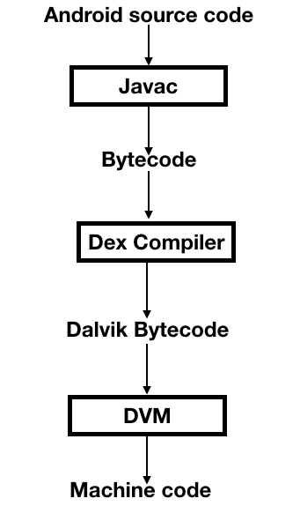
02
System configurations
Why Android uses DVM/ART and not JVM?
Mobile Environment is not as powerful as your computer systems (majorly). There are battery and ram constraints. DVM was specifically optimized in order to run on Android.
JVM uses a Stack-based model and DM uses a Register based model. ART uses AOT based approach and DVM uses JIT.
Android Run-Time (ART)
Java Virtual
Machine (JVM)
Dalvik Virtual Machine (DVM)

Slide 10
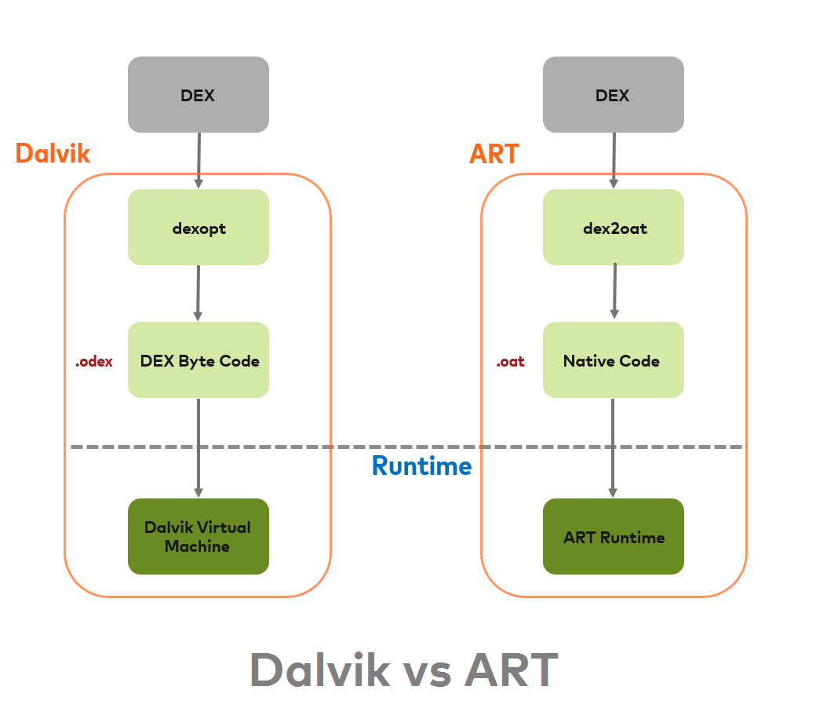
02
System configurations
AheadOfTime (AOT)
ART is equipped with an Ahead-of-Time compiler. During the app’s installation phase, it statically translates the DEX bytecode into machine code and stores in the device’s storage.

Slide 11

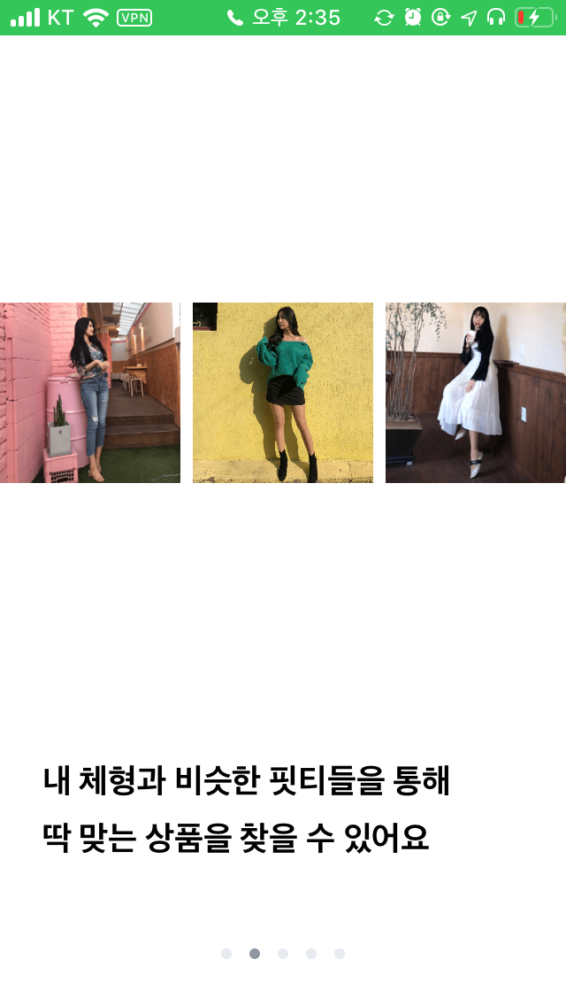
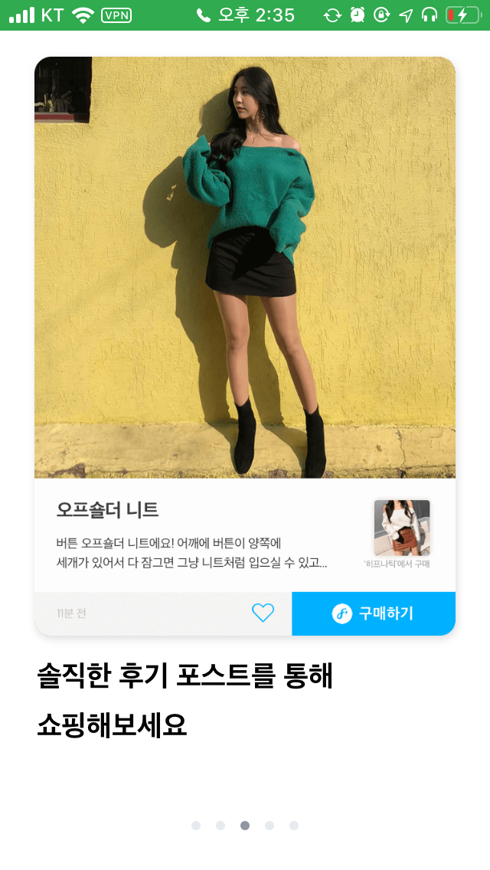
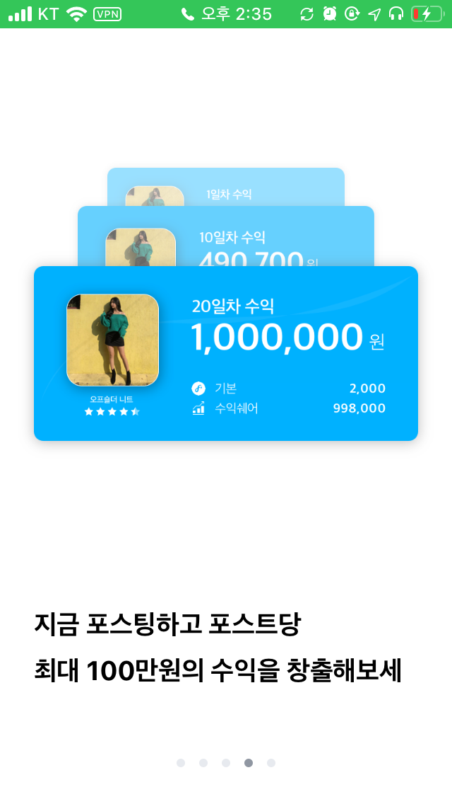
03
Main functions
User related functions
Account registration and user personalization
User home screen and main pages
Fitts’s store
Review (point) system
Post to earn money

Slide 12
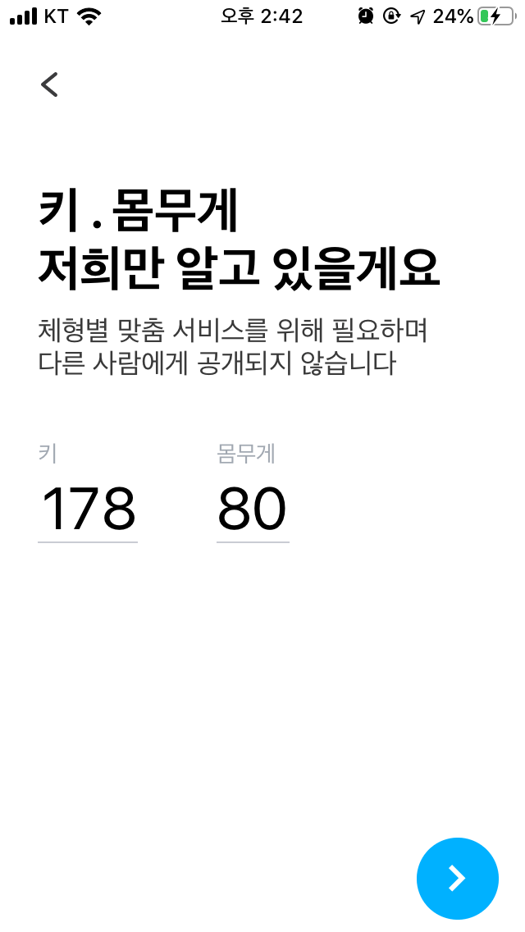
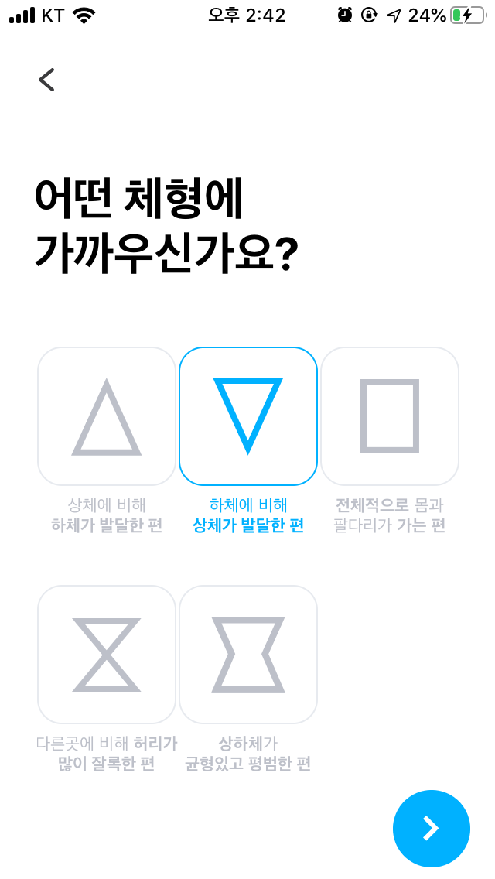
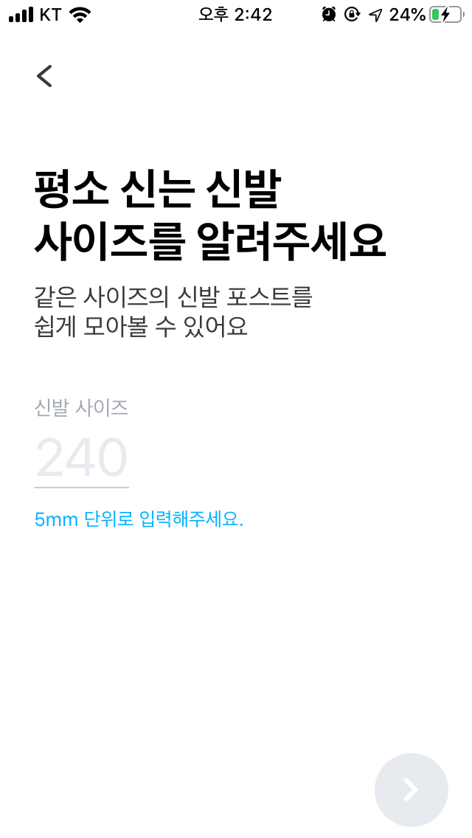
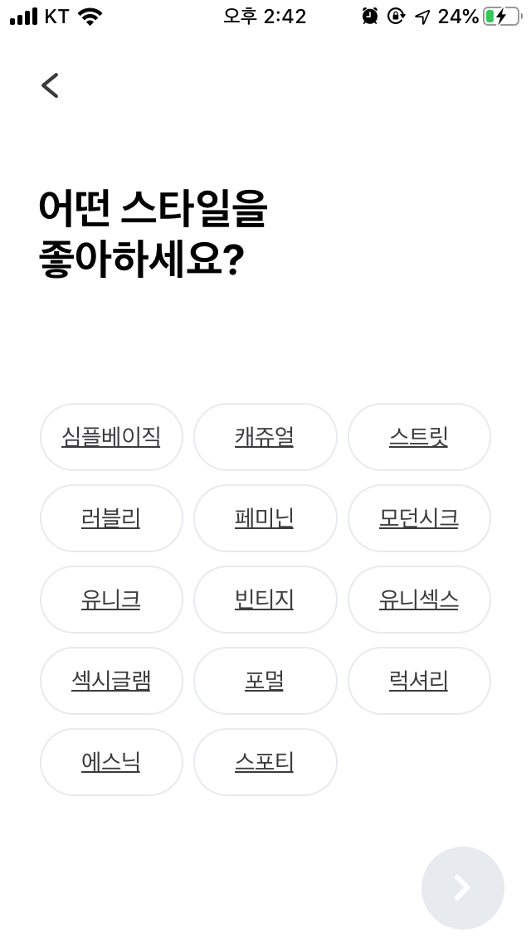

03
Main functions
Account registration and user personalization
Enter your information (e.g., height, body shape, etc...)
The information will be stored into your personalization database

Slide 13
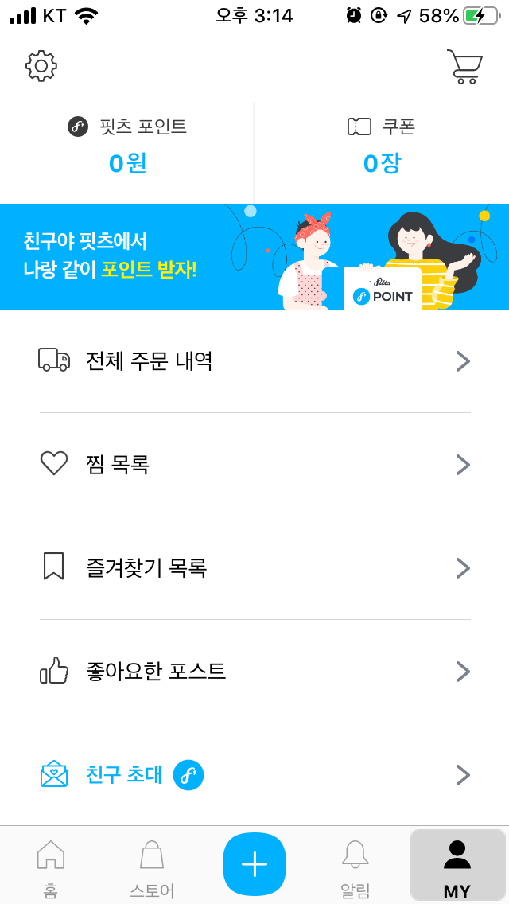
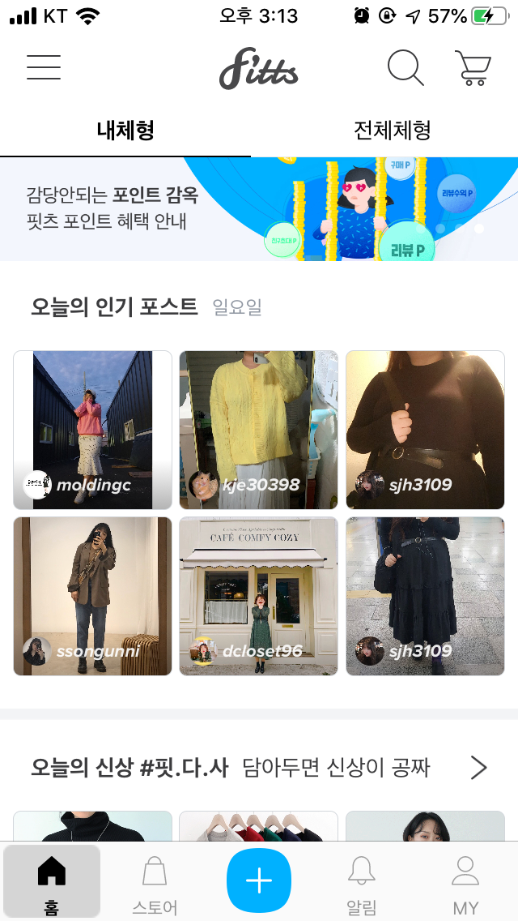
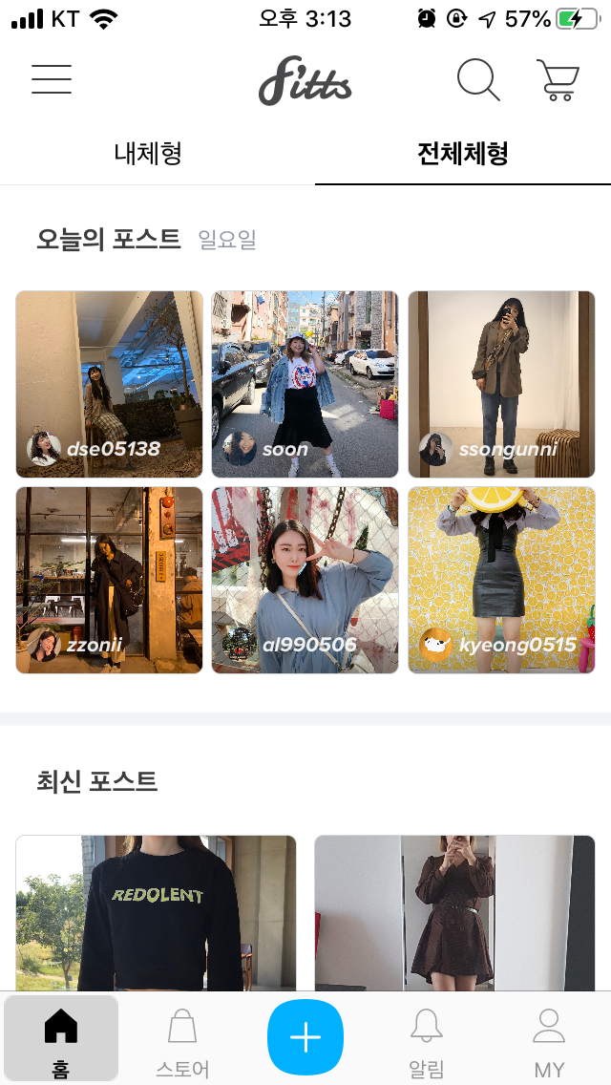
03
Main functions
User home screen and main pages
There are many postings (e.g., popular, recent, brand new outfits) by body shape

Slide 14
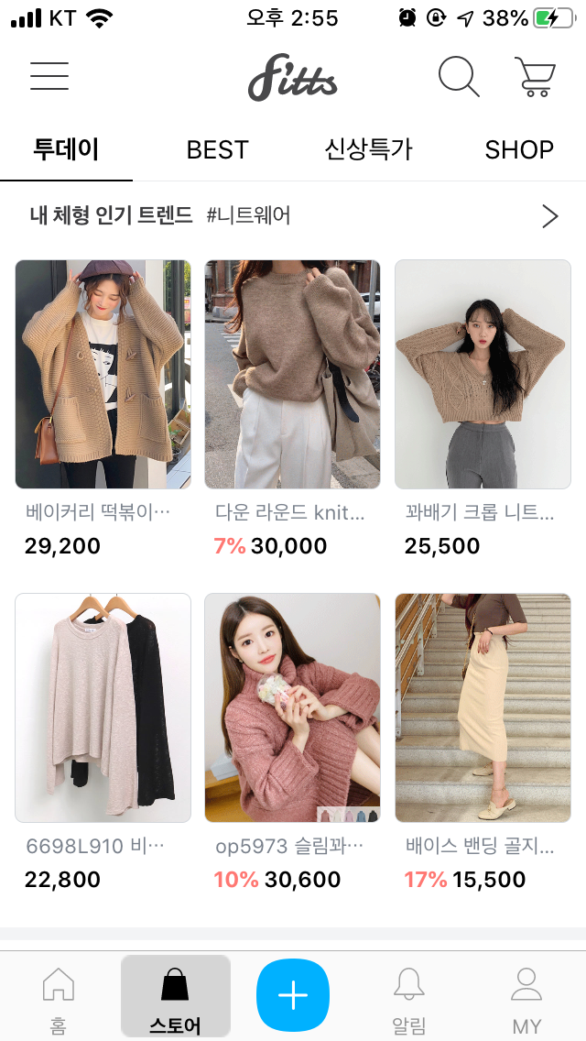
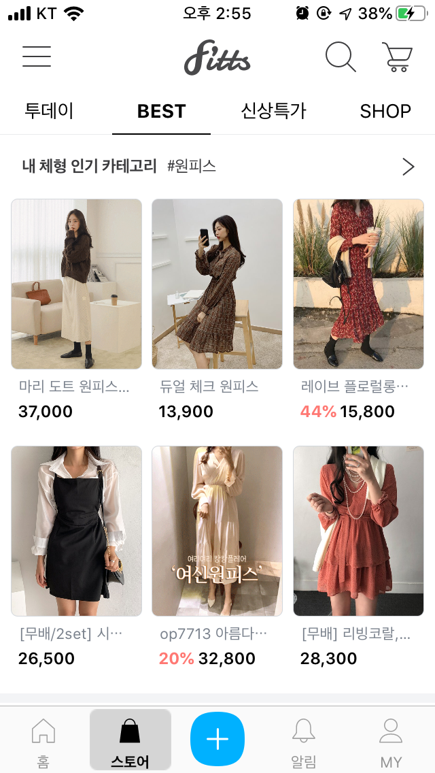
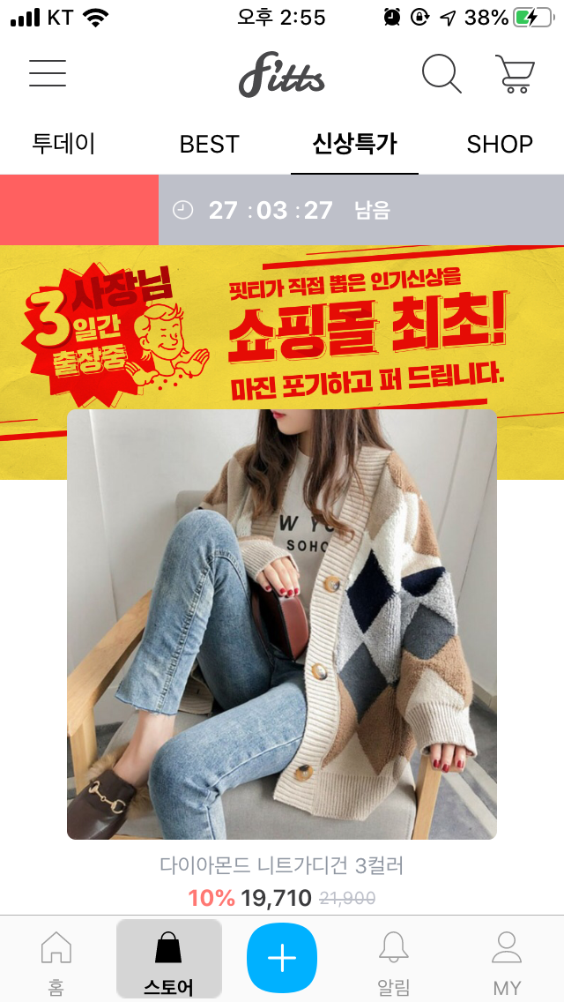
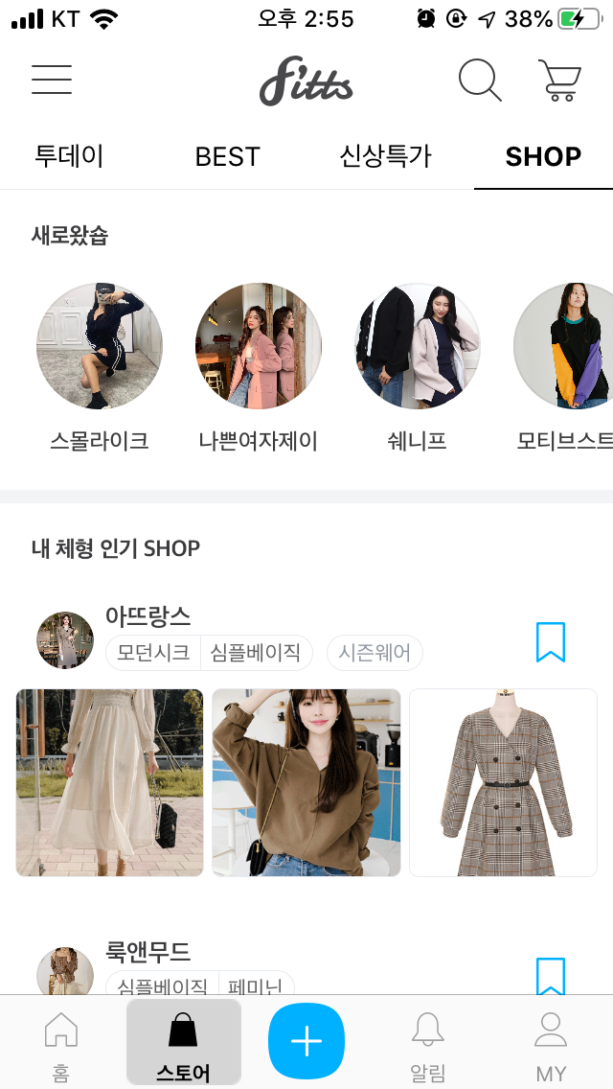
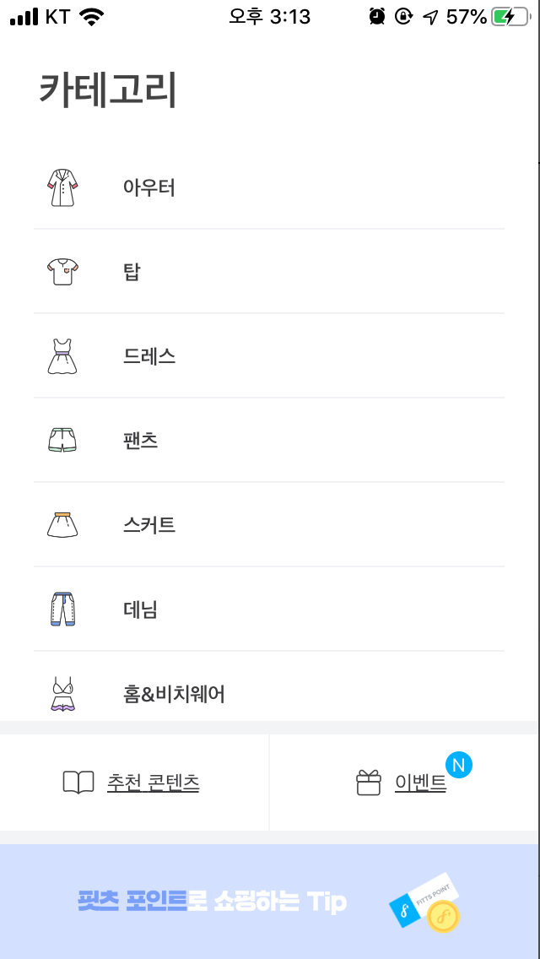
03
Main functions
Fitts’s store
Just like all other e-commerce, you can easily make payment with bunch of payment options (don’t forget the promotions also)

Slide 15
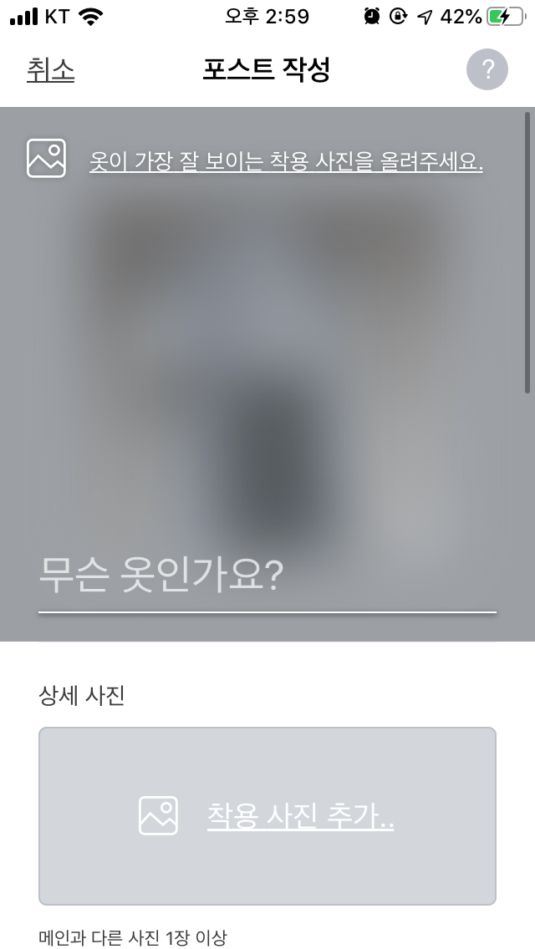
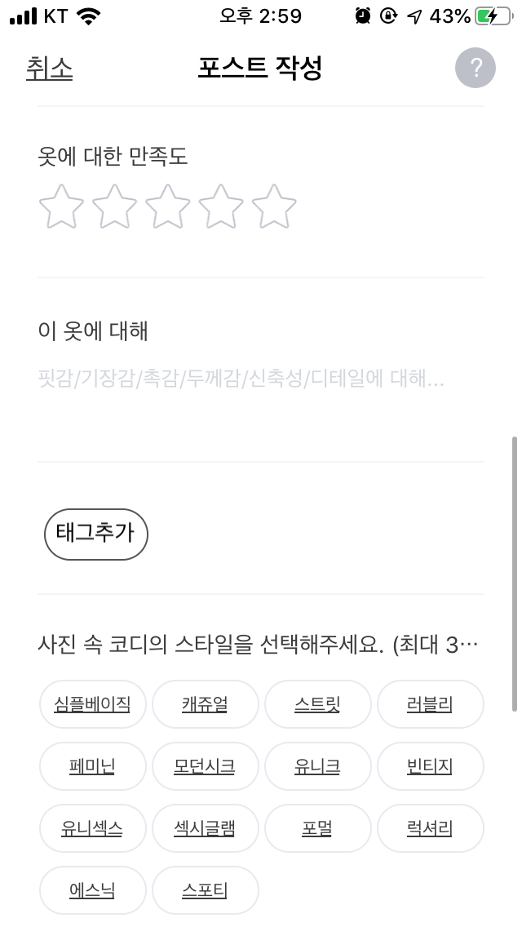
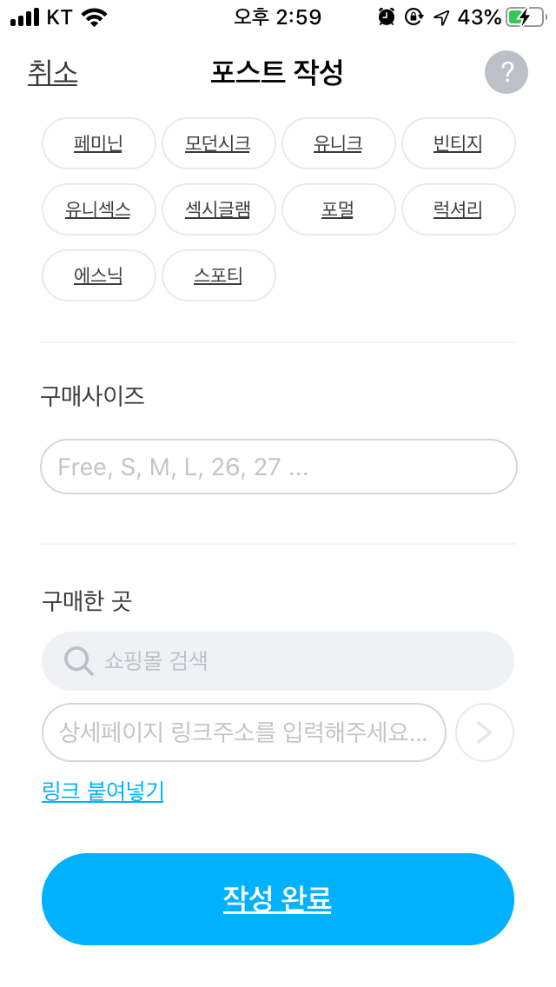
03
Main functions
Review (point) system
Posting equals money in Fitts

Slide 16
03
Main functions
User can upload reviews about outfits, shoes, bags using their own creativity, some good practice are:
Nice pictures
Appropriate star rating
The type of styles
Size of the product
Links to buy the product

Slide 17
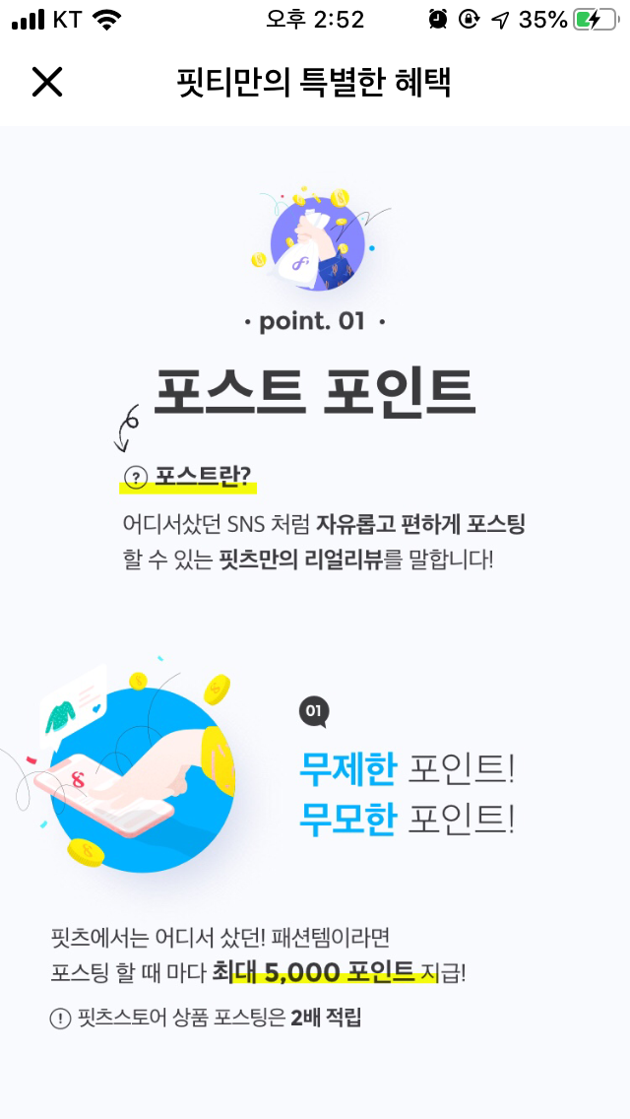




03
Main functions
Earn money by posting reviews, shopping, inviting peoples, and complete some events
Fitts points has as same as cash in Fitts system
You can use the money to buy extra products or just save it

Slide 18
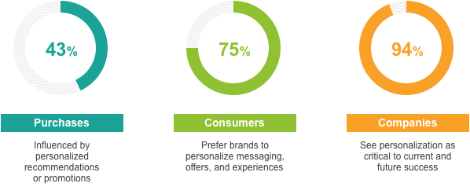
04
Reasons for selection
User/consumer's perspectives
According to data presented by Nosto at a recent Growing Your Online Funnel Webinar, personalization is a leading factor in ecommerce at large:
By tracking user behaviour, either session-by-session or by account, fashion sellers can build Netflix-like personalization into the onsite experience.
Notes:
Talk about why fitts fit with current trend of market (general ideas)​
https://www.shopify.com/enterprise/ecommerce-fashion-industry​
​
According to data presented by Nosto at a recent Growing Your Online Funnel Webinar, personalization is a leading factor in ecommerce at large:​
43% of purchases are influenced by personalized recommendations or promotions​
75% of consumers prefer brands to personalize messaging, offers, and experiences​
94% of companies see personalization as critical to current and future success​
By tracking user behavior, either session-by-session or by account, fashion sellers can build Netflix-like personalization into the onsite experience.​
​
​
​
​

Slide 19


04
Reasons for selection
Team2 perspectives on Fitts
Personal data is secured
User do not need to input their personal info apart from their body's info
Good accessibility
Interfaces is simple when using Fitts app
Good recommendation system
Review is very reliable because of Fitts's reward point feature
Features is scalable
There are many possibility to improve Fitts

Slide 20
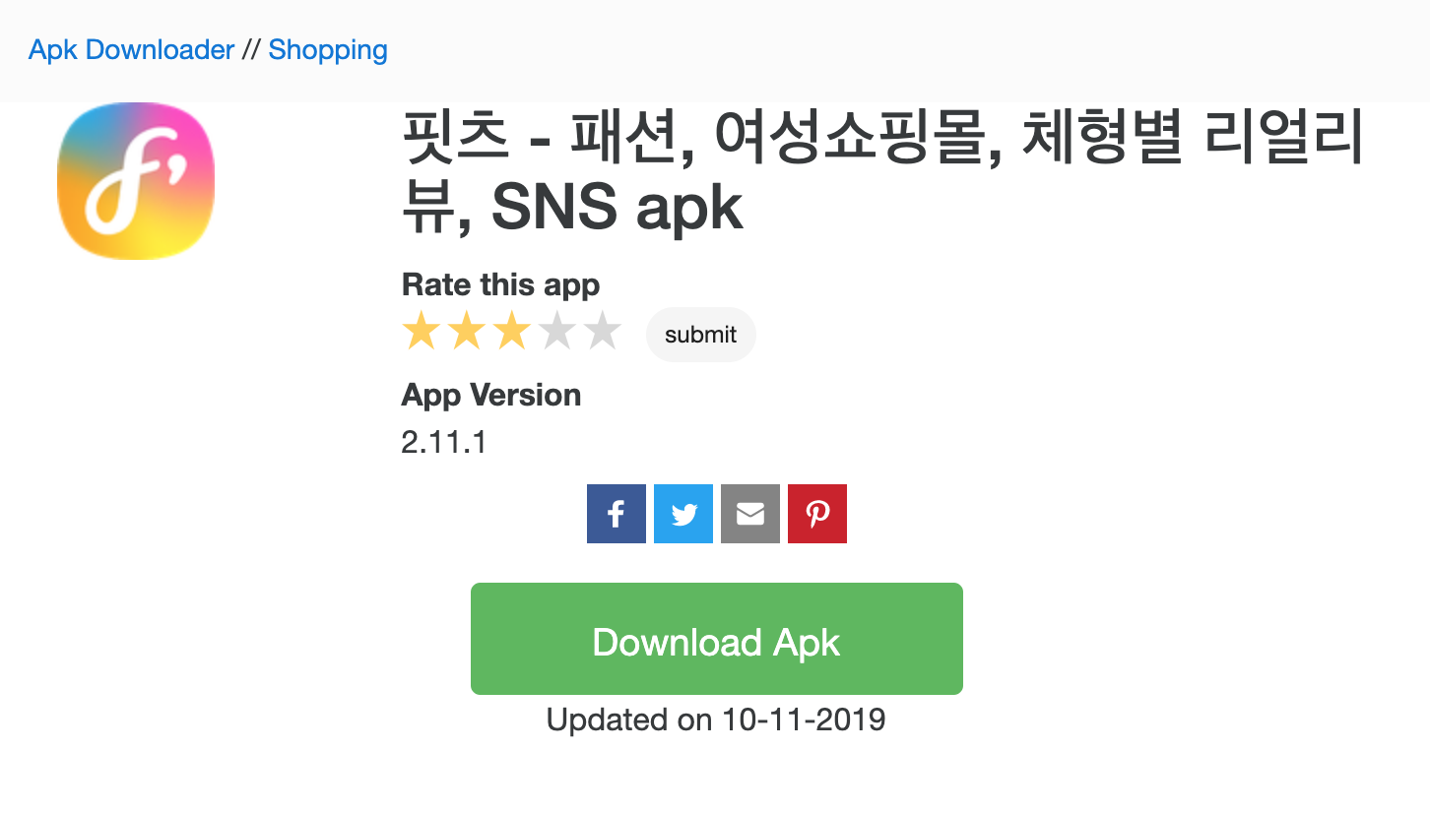
04
Reasons for selection
Developer's perspectives
Reverse engineering is possible using APK provided
https://github.com/skkuse-adv/2019Fall_team2/blob/master/analysis/README.md

Slide 21
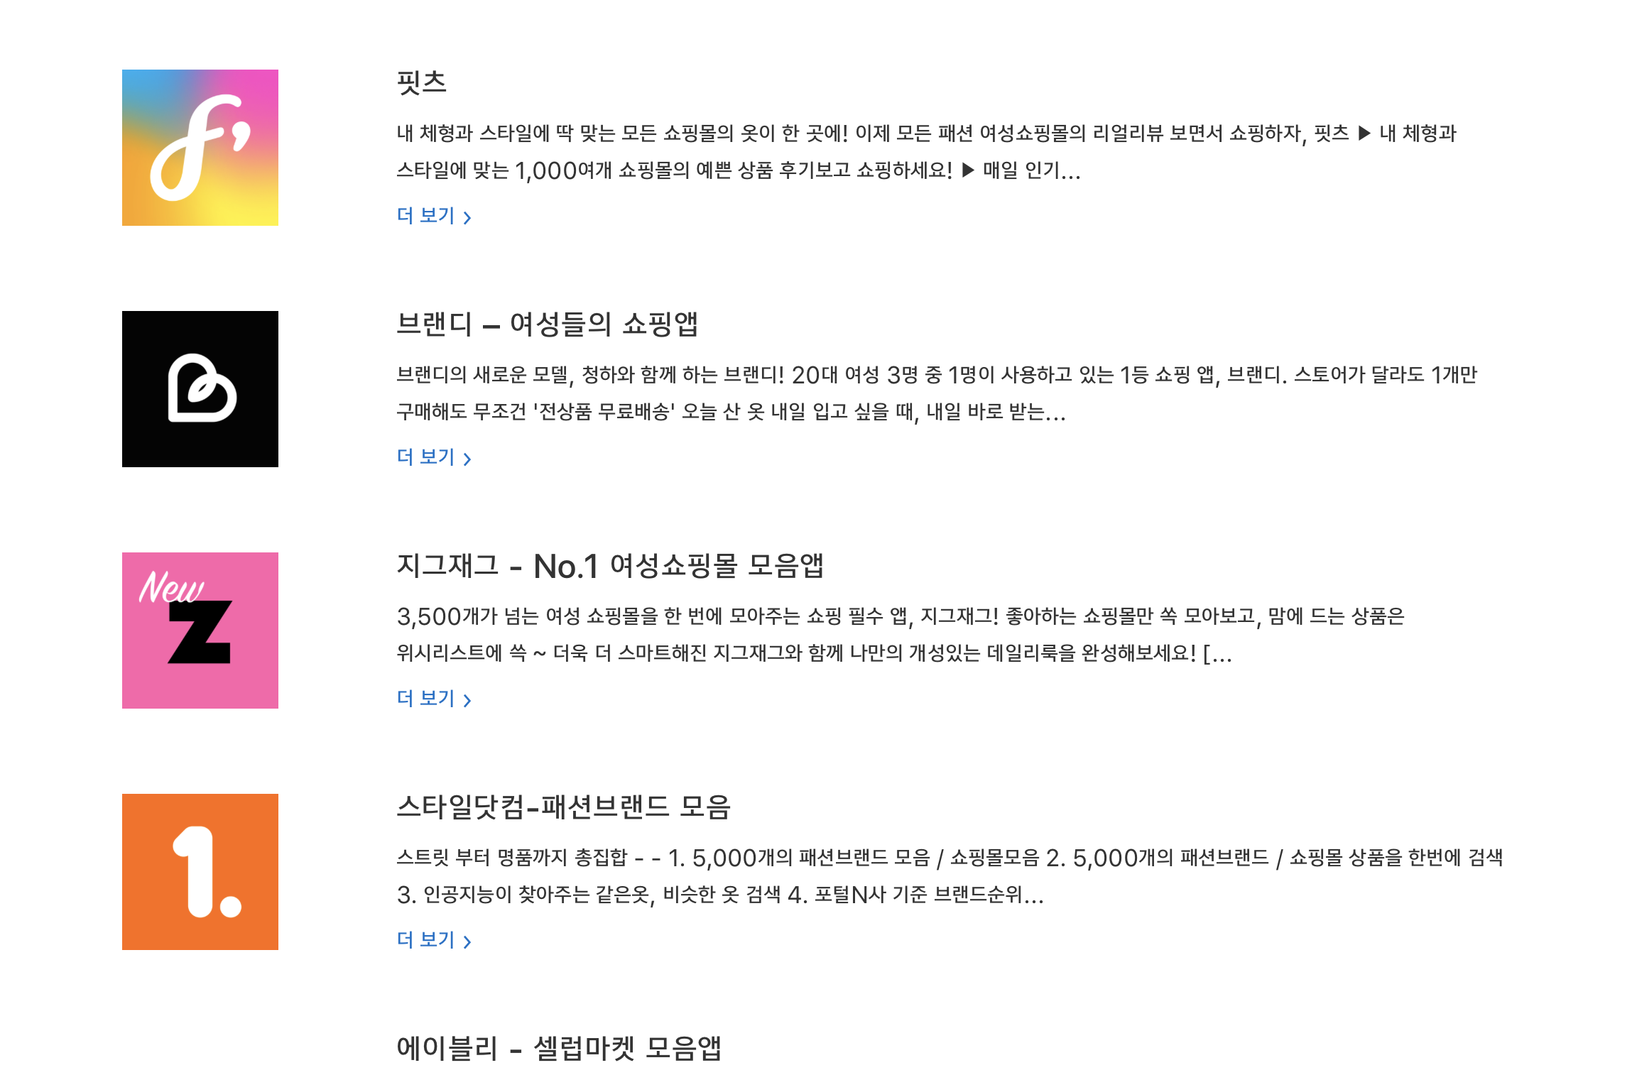
05
Related existing systems
Application | Advantages | Disadvantages
 | Get the items by trend and body type Earn money by review | Fitts spend too much attention on women rather than men clothing market
 | Free and fast shipping Updated trending items | There are some UX bugs make user feels uncomfortable
 | Create an own set of store and see the items of those in the set Store ranking | There are some UX bugs make user feels uncomfortable
Fitts
Brandy
ZigZag

Slide 22
Thank You
Personalization: Fitts
Team 2

Slide 23
Q&A

